Slide 1
BATCH-12
ONE YEAR LIFE EXPECTANCY THORACIC SURGERY USING IBM WATSON STUDIO

Slide 2

ONE YEAR LIFE EXPECTANCY THORACIC SURGERY USING IBM WATSON STUDIO
MINI PROJECT
presented by :
Puppala Nagendra(207Y1A1224)
Dodla Shilpa(207Y1A1243)
Under The Guidance Of
Mrs . Karimunnisa shaik
(Assistant Professor)
Department Of Information Technology

Slide 3
Abstract
The scope of this paper is to propose a life expectancy rate and examine the mortality after thoracic surgery which takes into account the different importance of various features which can have an effect in the end result. The data of the patients collected after diagnosis have been used as the dataset.
Various metrics which affect the result have been analysed with the help of random forest and decision tree algorithms to better understand the consequences of post-surgery. Thus, it enables us to have better comprehension of various algorithms and also some important parameters are selected for the construction of a better model.
In addition, we have several classification features such as the presence of pain before surgery, hemoptysis before surgery, cough before surgery, whether the patient is a smoker, whether the patient has asthma, and a few others. This classification model predicts whether the patient will survive for a year-long period or not with better selection of the data features.
Many machine learning models like Naïve Bayes, Decision Tree, Random forest, and Logistic regression have been applied for post thoracic surgery life expectancy prediction.
Also, work has been carried out towards attribute ranking and selection in performing better in improving prediction accuracy with machine learning algorithms.
On comparing the accuracy, the results indicate that the deep neural network can be efficiently used for predicting life expectancy

Slide 4
CONTENTS
Abstract
Introduction
Existing System And Proposed System
Basic Architecture
Hardware And Software Requirements
Libraries And Algorithms Used
What Is Thoracic Surgery?
Steps Involved In Thoracic Surgery
Importance Of One Year Life Expectancy
What Is Watson Studio?
Challenges Using Watson Studio
Benefits Using Watson Studio
Conclusion And Future Implications
References

Slide 5
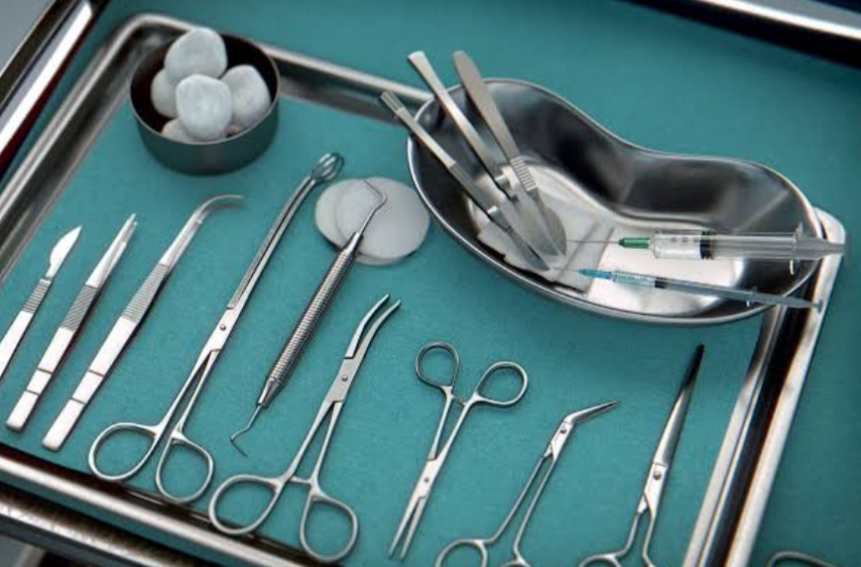
Introduction
The introduction of computer applications into the medical industry has had a direct impact on doctors productivity and accuracy in recent years.
One of these applications is the study of health outcomes. In most nations, cancer is now one of the leading causes of mortality.
Thoracic surgery is the most common operation performed on lung cancer patients.
Massive datasets of cancer have been collected and made available to medical professionals as a result of the advancement of new tools in the field of medicine.
Many machine learning techniques such as KNN, Logistic regression, random forest etc...are used to predict life expectancy for post thoracic surgery.

Slide 6
EXISTING AND PROPOSED SYSTEM
EXISTING SYSTEM
PROPOSED SYSTEM
Existing system is build on older technologies or solutions.
In existing system the data integration was up to the mark
In existing system there was no automation features where all the work was done manually.
In existing system tracking continuous process of the patient was difficult.
Proposed system which is designed using current technologies which include AI and machine learning tools.
In proposed system we improved data integration capabilities ,allowing it to seamlessly collect and analyse the data.
Watson studio introduced automation features machine learning algorithms to assist the surgeons in pre operative planning and post operative monitoring.
Here continuous monitoring is allowed , the surgical team track the patient progress and make adjustments to give better outcome.

Slide 7
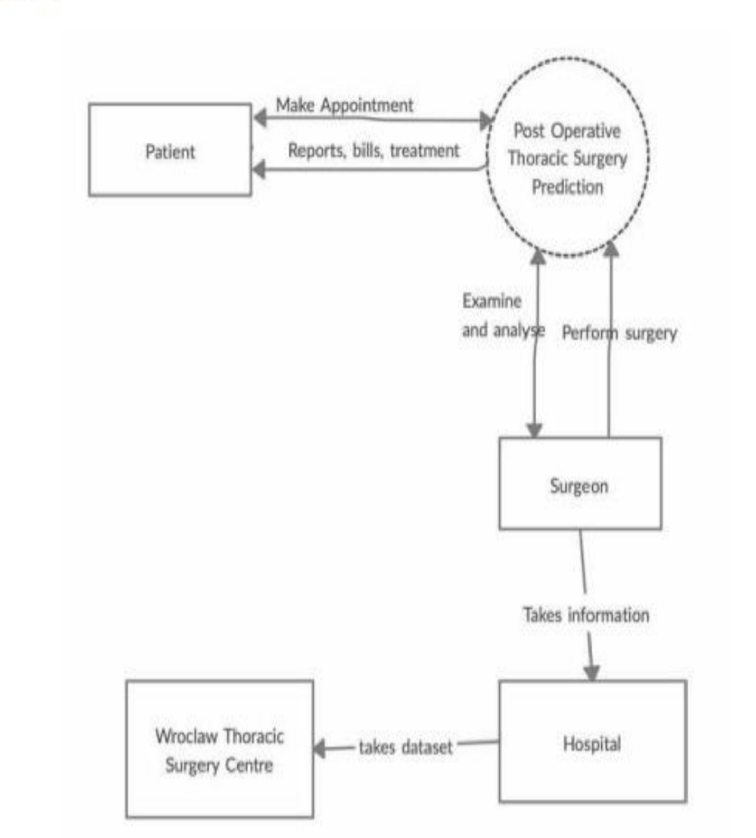
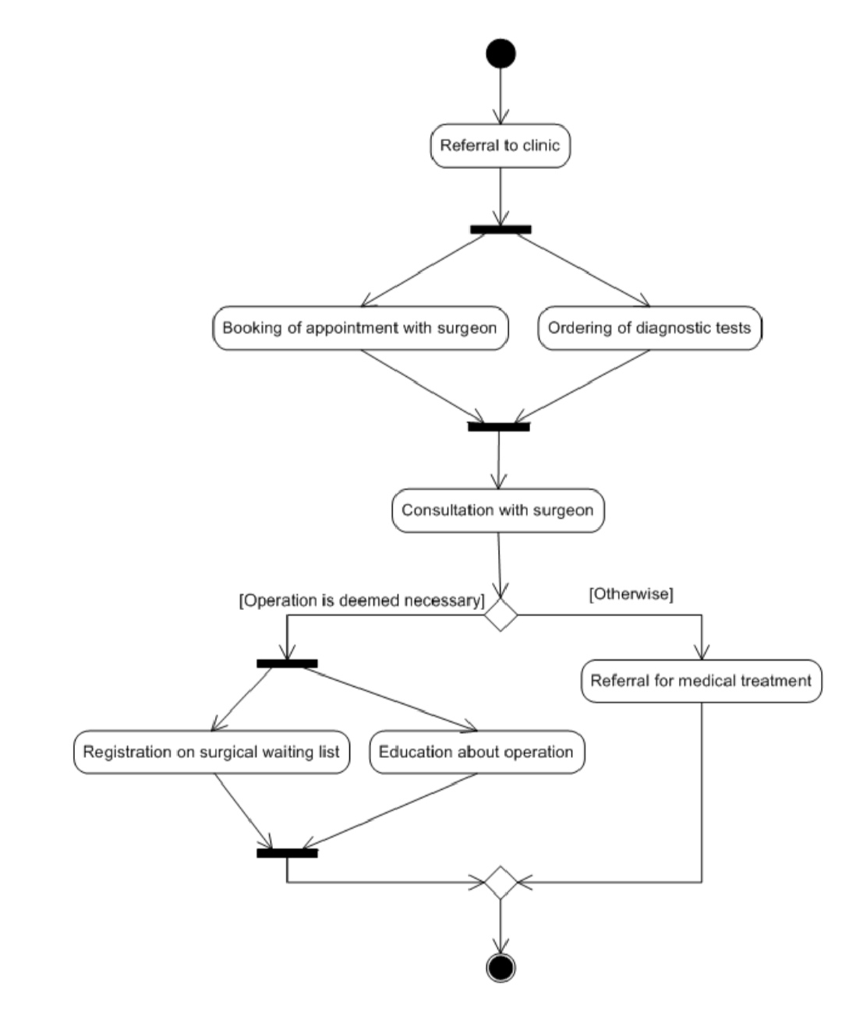
Basic architecture

Slide 8
Hardware and software requirements
Hardware requirements
Software requirements
System : Intel CORE i5
Hard disk : 2 TB
Screen : 15VGA colour
Ram : 16GB
Operating system : windows 11
Dataset : CSV file, TSV file
Programming Language : python
IDE: Jupiter, Python 3,7,google collab

Slide 9
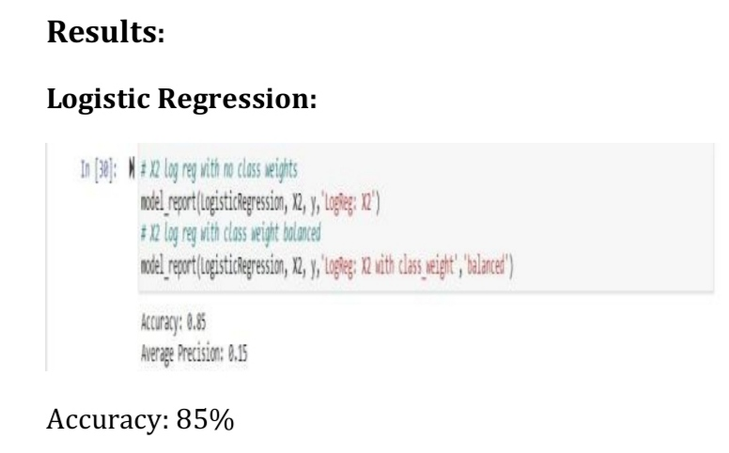
LIBRARIES AND ALGORITHMS USED
ALGORITHMS USED
LIBRARIES USED
KNN – accuracy 81%
Random Forest – 83%
Logistic Regression – accuracy 85%
we got the highest accuracy in predicting the problem using logistic regression when compared to other algorithms.
Numpy
Pandas
Seaborn
Matplotlib
sklearn

Slide 10
COMPARISIONS
Other existing system
Our system
1. Manual data collection and analysis.
2. Limited predictive capabilities.
3. Lack of real-time patient monitoring.
4. Inefficient resource allocation.
5. Limited collaboration among healthcare professionals.
1. Automated data collection and analysis.
2. Enhanced predictive analytics for better patient outcomes.
3. Real-time monitoring of patient vital signs.
4. Optimal resource allocation through AI-driven recommendations.
5. Improved collaboration among surgeons and medical staff through data sharing and insights.

Slide 11
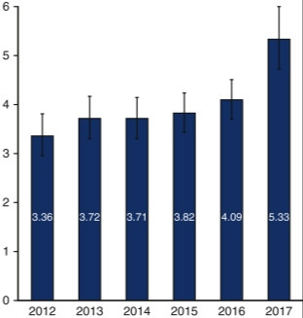
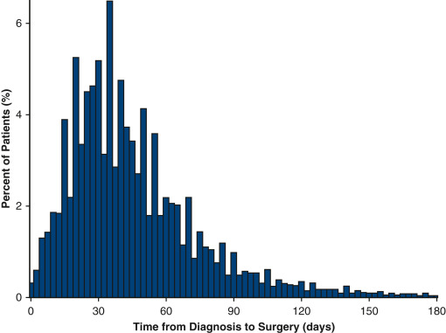
Graphs collected

Slide 12
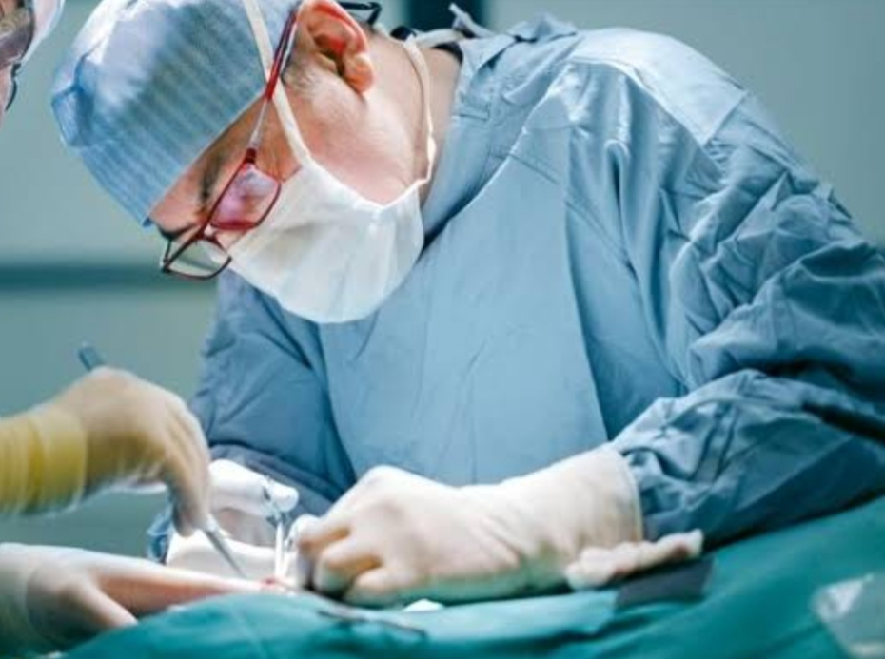
What is thoracic surgery?
Thoracic surgery refers to the treatment of organs within the chest, including the lungs, heart diseases.
Importance: Thoracic surgery is often used to treat life-threatening conditions such as lung cancer, heart disease and cancer.
Challenges: Thoracic surgery is a complex and challenging field that requires a high degree of skill, training, and expertise.
Thoracic surgeons, also known as cardiothoracic surgeons, are highly trained medical professionals who perform a wide range of procedures.

Slide 13
Steps in thoracic surgery
Step 1: Collect and Prepare Data
Collect and prepare patient data from various sources, including electronic health records, lab test results, and medical images.
Step 2: Analyse Data
Use IBM Watson Studio to analyse patient data and identify risk factors that may affect one-year expectancy.
Step 3: Predict Outcomes
Use IBM Watson Studio to predict long-term patient outcomes based on the analysis of patient’s data
Step 4: Optimize Surgical Procedures
Use the insights gained from IBM Watson Studio to optimize surgical procedures for better patient outcomes.
Step 5: Monitor Post-Surgical Outcomes
Use IBM Watson Studio to monitor post-surgical outcomes and adjust treatment plans as needed

Slide 14
What is Watson studio?
IBM Watson Studio is an advanced analytics platform that helps organizations build and deploy AI models and applications.
What are the benefits of using IBM Watson Studio?
IBM Watson Studio allows for faster development and deployment of AI models and provides advanced analytics capabilities.
How can IBM Watson Studio be used in healthcare?
IBM Watson Studio can be used to improve patient outcomes, increase the efficiency of healthcare operations, and support clinical decision-making.
Watson Studio works by providing a collaborative environment where data scientists can import data, explore it, build and train machine learning models, and then deploy those models into production environments.
It leverages cloud computing resources and integrates with other IBM Watson services for AI capabilities. Overall, Watson Studio streamlines the end-to-end data science process, from data preparation to model deployment, making it a powerful tool for organizations looking to harness the potential of AI and machine learning.

Slide 15

Challenges using Watson studio?
five challenges that may arise during one year of life experiences :
Patient Complexity: Patients undergoing thoracic surgery often have complex medical histories and comorbidities. Managing these complexities can be challenging.
Surgical Complications: Thoracic surgery carries risks of complications such as infections, bleeding, or post-operative pain, which require careful monitoring and management.
Advanced Techniques: Staying updated with the latest surgical techniques and technologies in the field of thoracic surgery is crucial but can be challenging due to the rapid advancements in medical technology.
Communication: Effective communication with patients, their families, and the multidisciplinary healthcare team is vital but can sometimes be challenging, especially in high-stress situations.
Data Management and Analysis: If you are using Watson Studio for data analysis, challenges may include collecting and managing patient data, ensuring data privacy and security, and deriving meaningful insights from the data.

Slide 16

Benefits using Watson studio?
Improved Patient Outcomes
Using IBM Watson Studio can help improve patient outcomes by identifying risk factors, predicting long-term outcomes, and optimizing surgical procedures.
Increased Efficiency
Using IBM Watson Studio can increase the efficiency of surgical procedures by reducing the time and resources needed to analyse patient data and plan surgical procedures.
Reduced Healthcare Costs
Using IBM Watson Studio can help reduce healthcare costs by improving patient outcomes, reducing the need for additional procedures, and minimizing complications.

Slide 17
Conclusion and future implications
Conclusion
IBM Watson Studio is a powerful tool that can be used to improve patient outcomes and increase the success rate of surgical procedures in thoracic surgery.
Improved Survival Rates: Thoracic surgery, such as lung or heart surgery, has shown significant improvements in one-year life expectancy for patients with various conditions.
Patient Selection: Success depends on careful patient selection, considering factors like age, overall health, and the specific surgical procedure.
Reduced Mortality: Advances in surgical techniques, and post-operative care have contributed to a decrease in surgical mortality rates.
Early Detection: Early diagnosis and intervention play a critical role in enhancing one-year survival, particularly in cases of lung cancer or cardiac conditions.
Individual Variability: Life expectancy after thoracic surgery can vary widely among patients due to factors like complications, comorbidities, and response to treatment.
Future Implications
The use of IBM Watson Studio in healthcare is expected to grow rapidly in the coming years, with potential applications in a range of medical specialties, including oncology, cardiology, and neurology.

Slide 18
REFERENCES
[1] V. Sindhu, S. A. S. Prabha, S. Veni and M. Hemalatha. (2014), “Thoracic surgery analysis using datamining techniques”, International Journal of Computer Technology & Applications, Vol. 5 pp.578-586.
[2] KonstantinaKourou , Themis P. Exarchos, Konstantinos P. Exarchos, Michalis V. Karamouzis and Dimitrios I. Fotiadisa. (2015), “Machine learning applications in cancer prognosis and prediction”, Computational and Structural Biotechnology Journal, Vol. 13,pp.8-17.
[3] KwetisheJoro Danjuma. (2015), “Performance evaluation of machine learningalgorithms in post-operative life expectancy in the lung cancer patients”, IJCSI International Journal of Computer Science Issues, Vol. 12, No. 2, pp.189-199 .
[4] Joseph A. Cruz, David S. Wishart. (2006), “Applications of machine learning in cancer prediction and prognosis”, Cancer Informatics, Vol. 2, pp.59-77 2006.

Slide 19
THANK YOU

